Slide 1
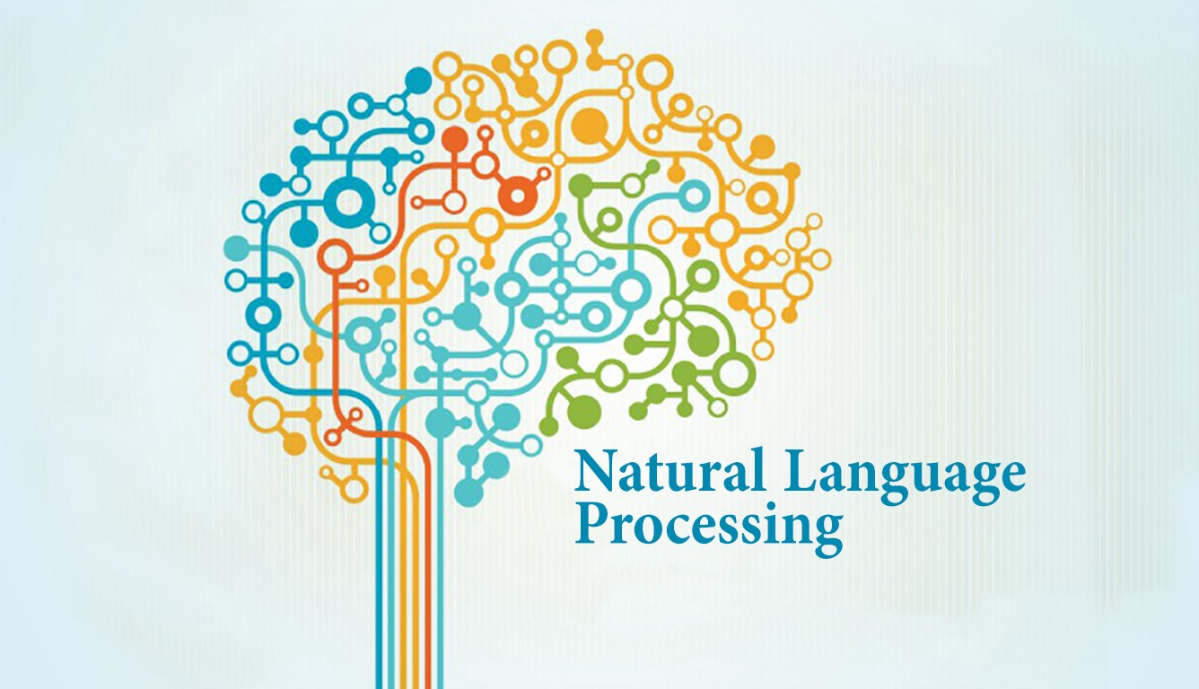
R. Joseph Manoj Ph.D.

Slide 2


Session Plan
Natural language processing - Intro
Data Science - Intro
NLP In Data Science
NLP Using NLTK
NLP Using spacy

Slide 3
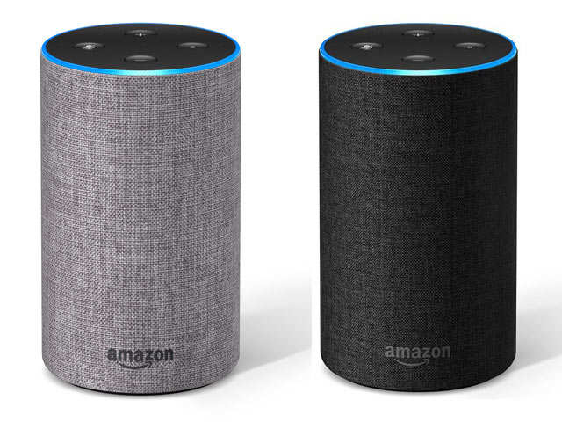
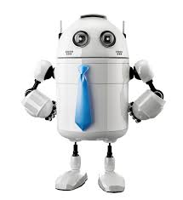


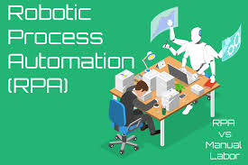


Slide 4
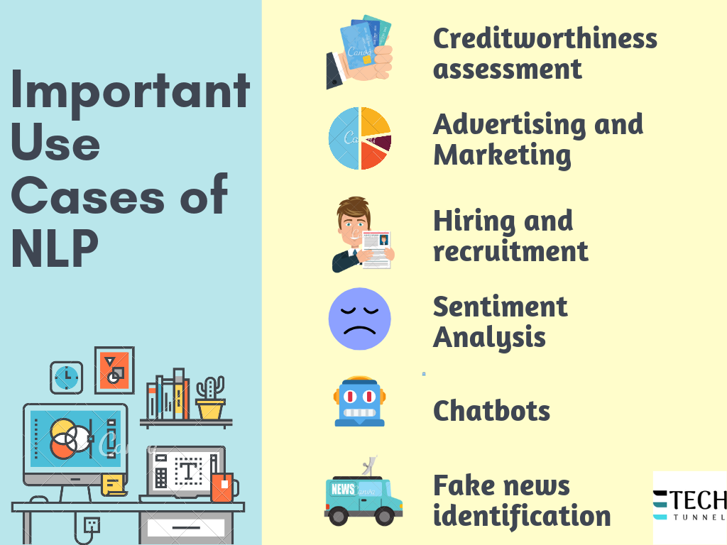

Slide 5
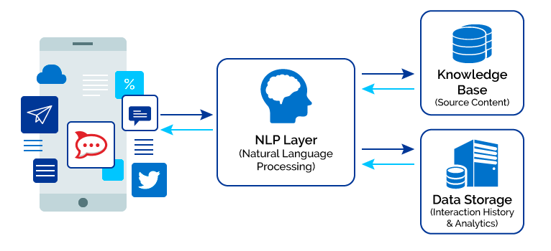
Chat Bot

Slide 6
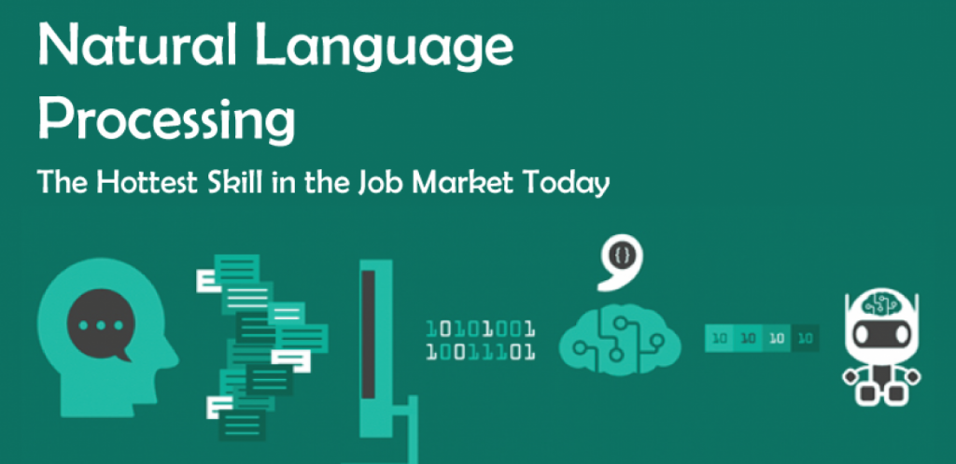

Slide 7
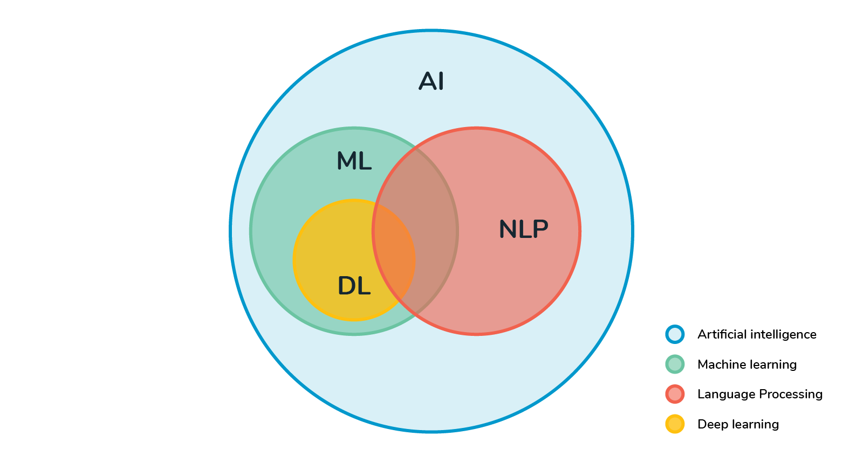
Natural Language Processing
Natural Language Processing or NLP is a field of Artificial Intelligence that gives the machines the ability to read, understand and derive meaning from human languages.
It deals mostly with unstructured data such as social media posts, email.
It is originated from the idea of Machine Translation (MT) which came to existence during the second world war (1940). For example, turning the Russian language to English language.
MT/NLP era started during 1966. This condition was better in the 1980 when the product provided result to customer (Speech understanding Application).
Neural Machine Translation (NMT) or deep learning models are introduced in NLP Applications.

Slide 8
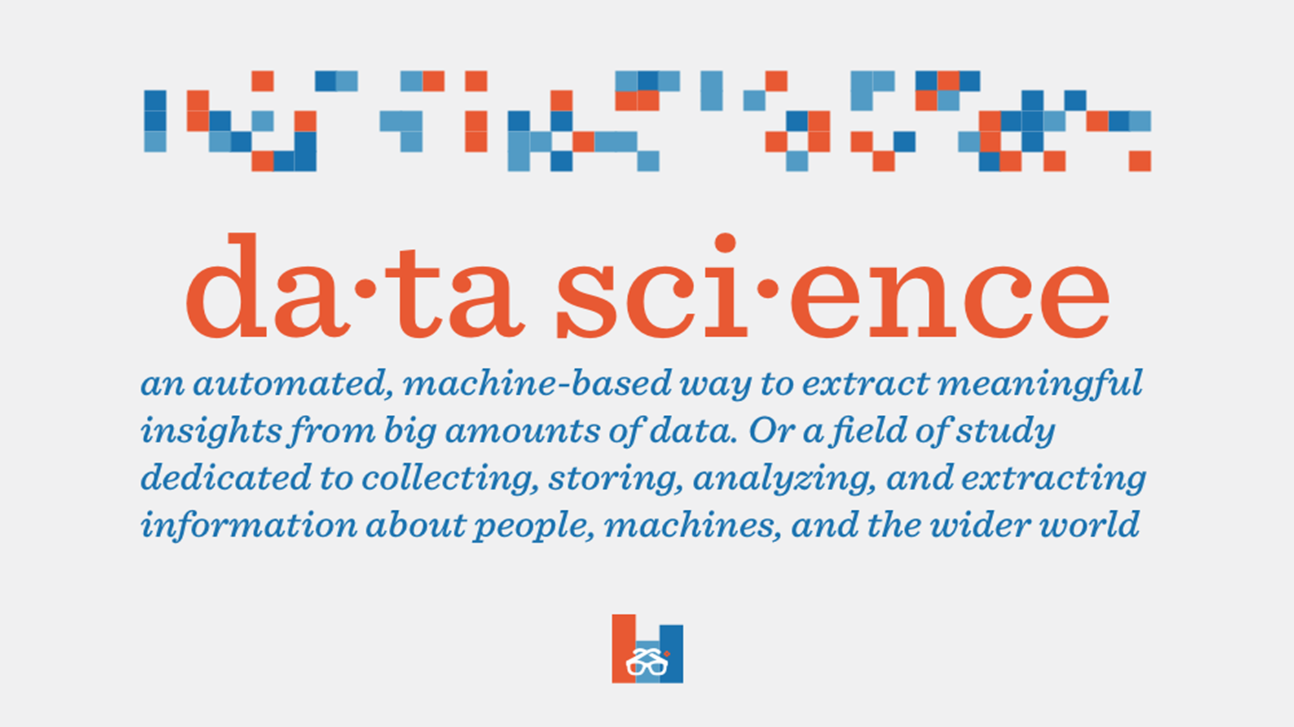


Slide 9
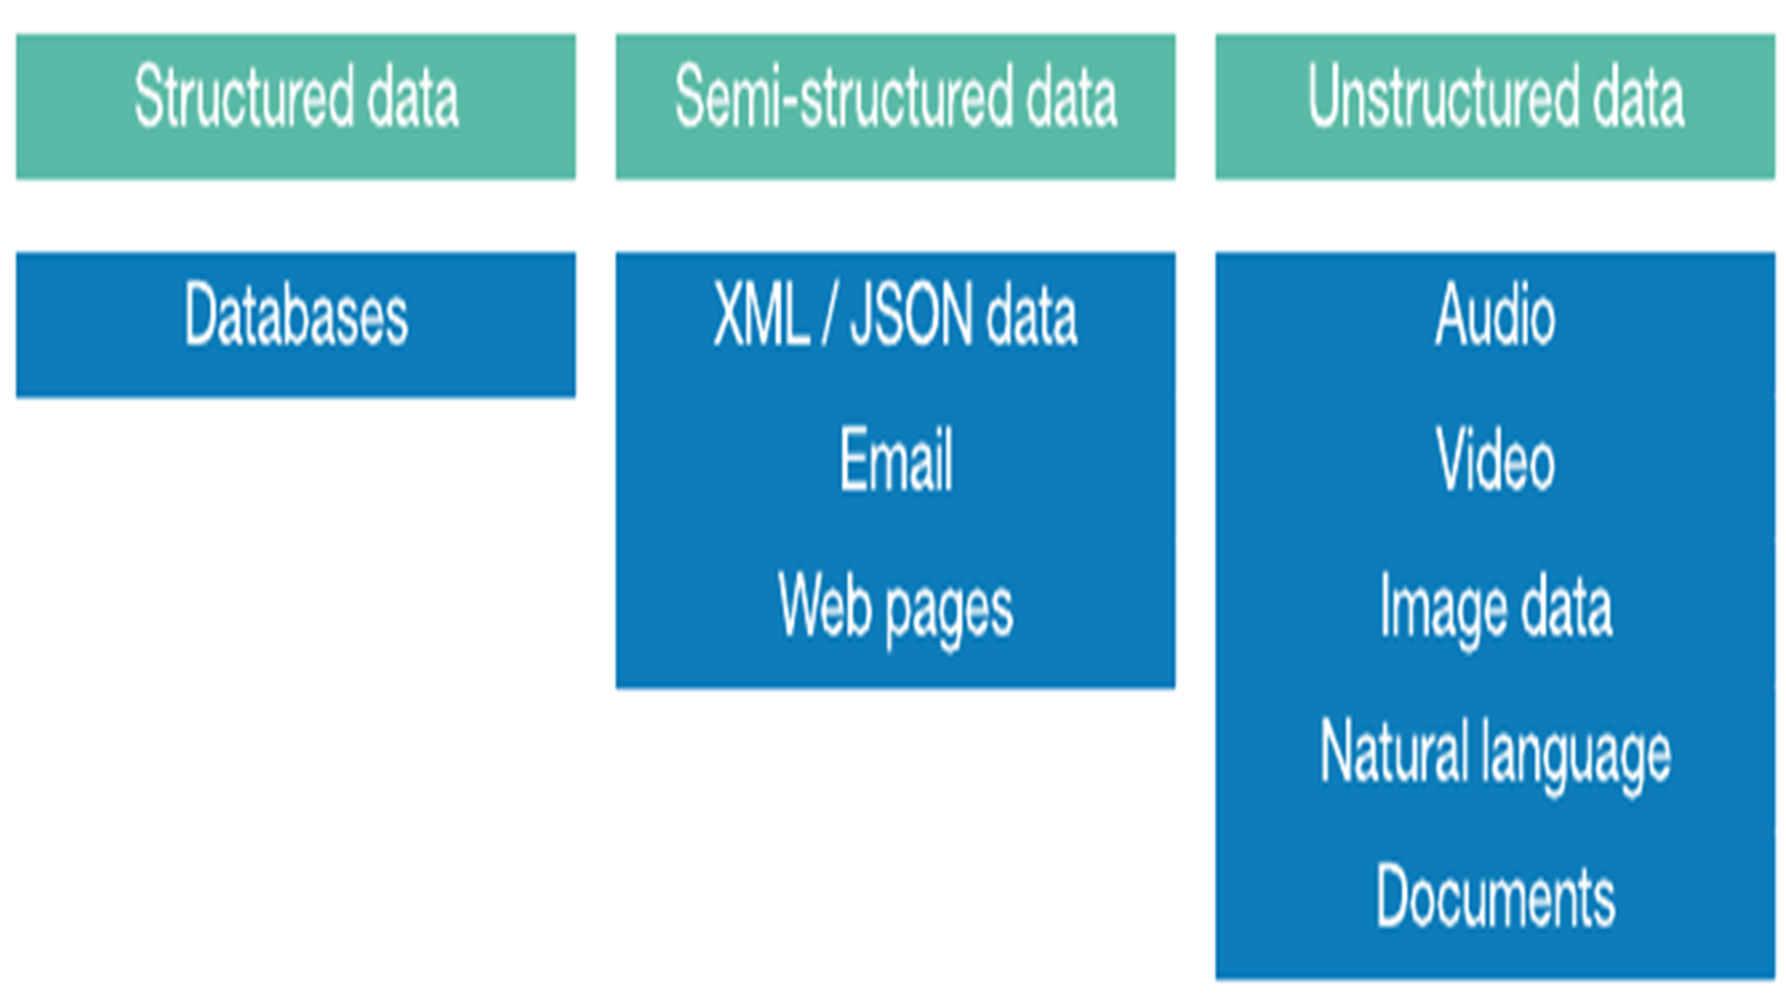

Slide 10
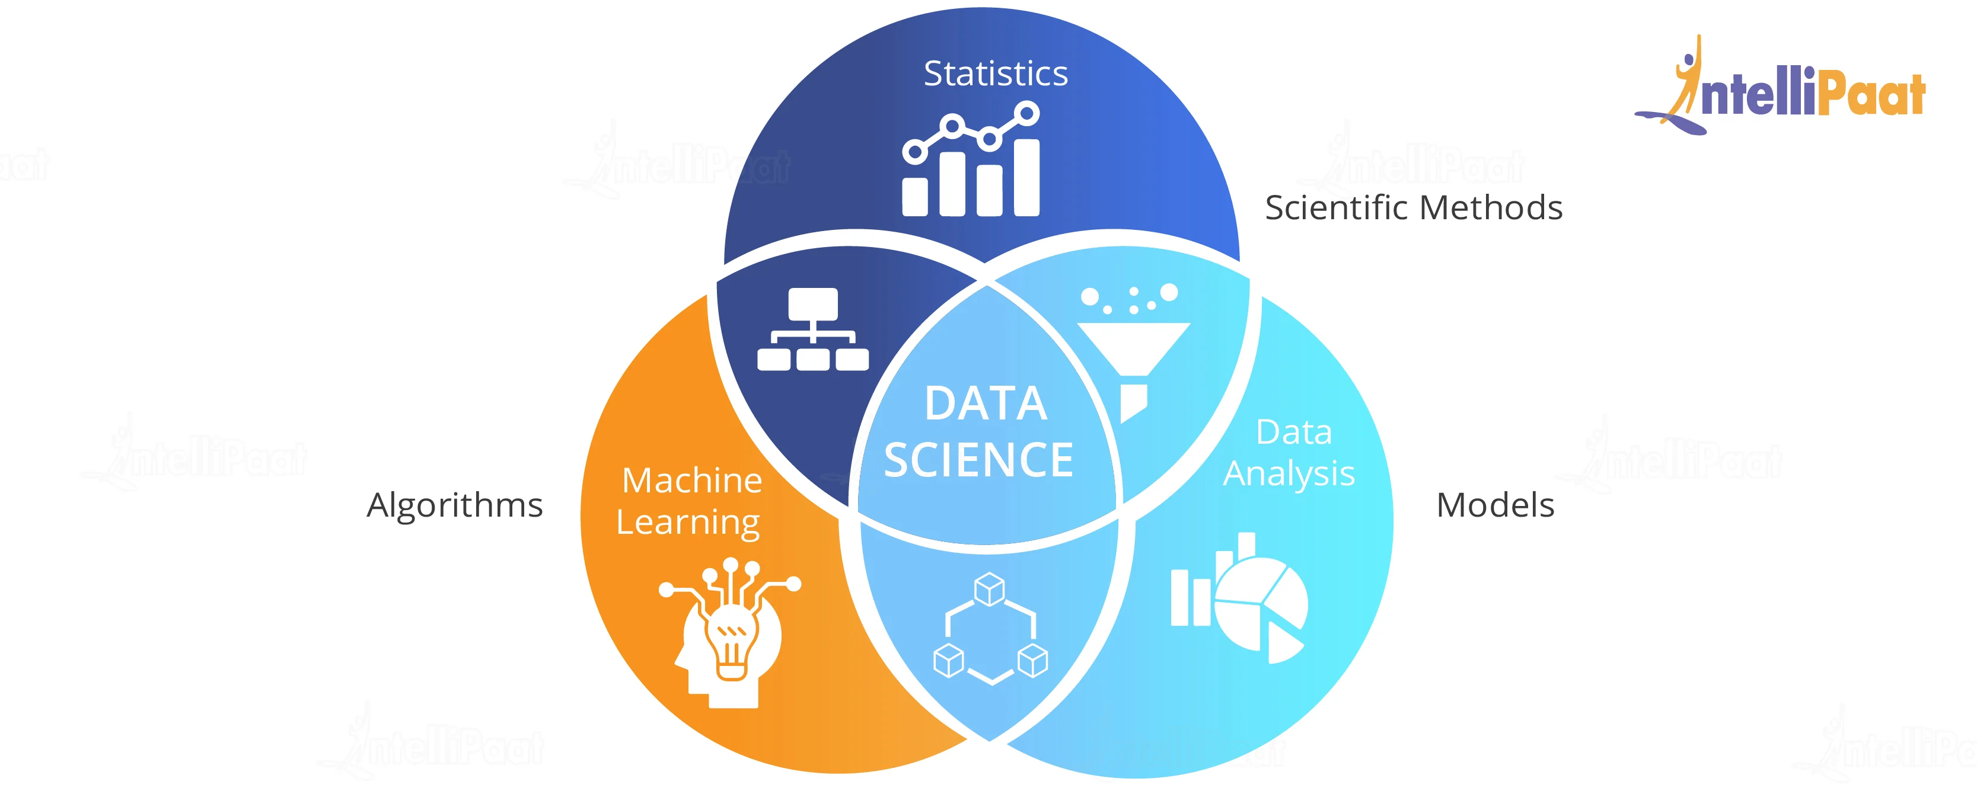
Data Science

Slide 11
NLP in Data Science
Modern organizations work with huge amounts of data.
Data can come in a variety of different forms including documents, spreadsheets, audio recordings, emails, JSON, and so many, many more.
One of the most common ways that such data is recorded is via text. That text is usually quite similar to the natural language that we use from day-to-day.
Knowledge of NLP is essential for Data Scientists since text is such an easy to use and common container for storing data.
Faced with the task of performing analysis and building models from textual data, one must know how to perform the basic Data Science tasks.
That includes cleaning, formatting, parsing, analyzing, visualizing, and modeling the text data.
It’ll all require a few extra steps in addition to the usual way these tasks are done when the data is made up of raw numbers.

Slide 12
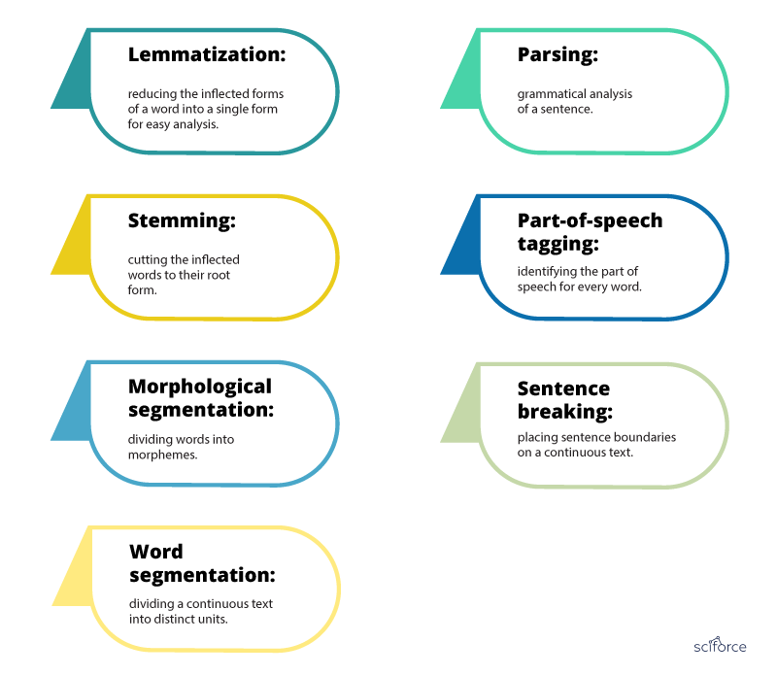
NLP Tasks

Slide 13
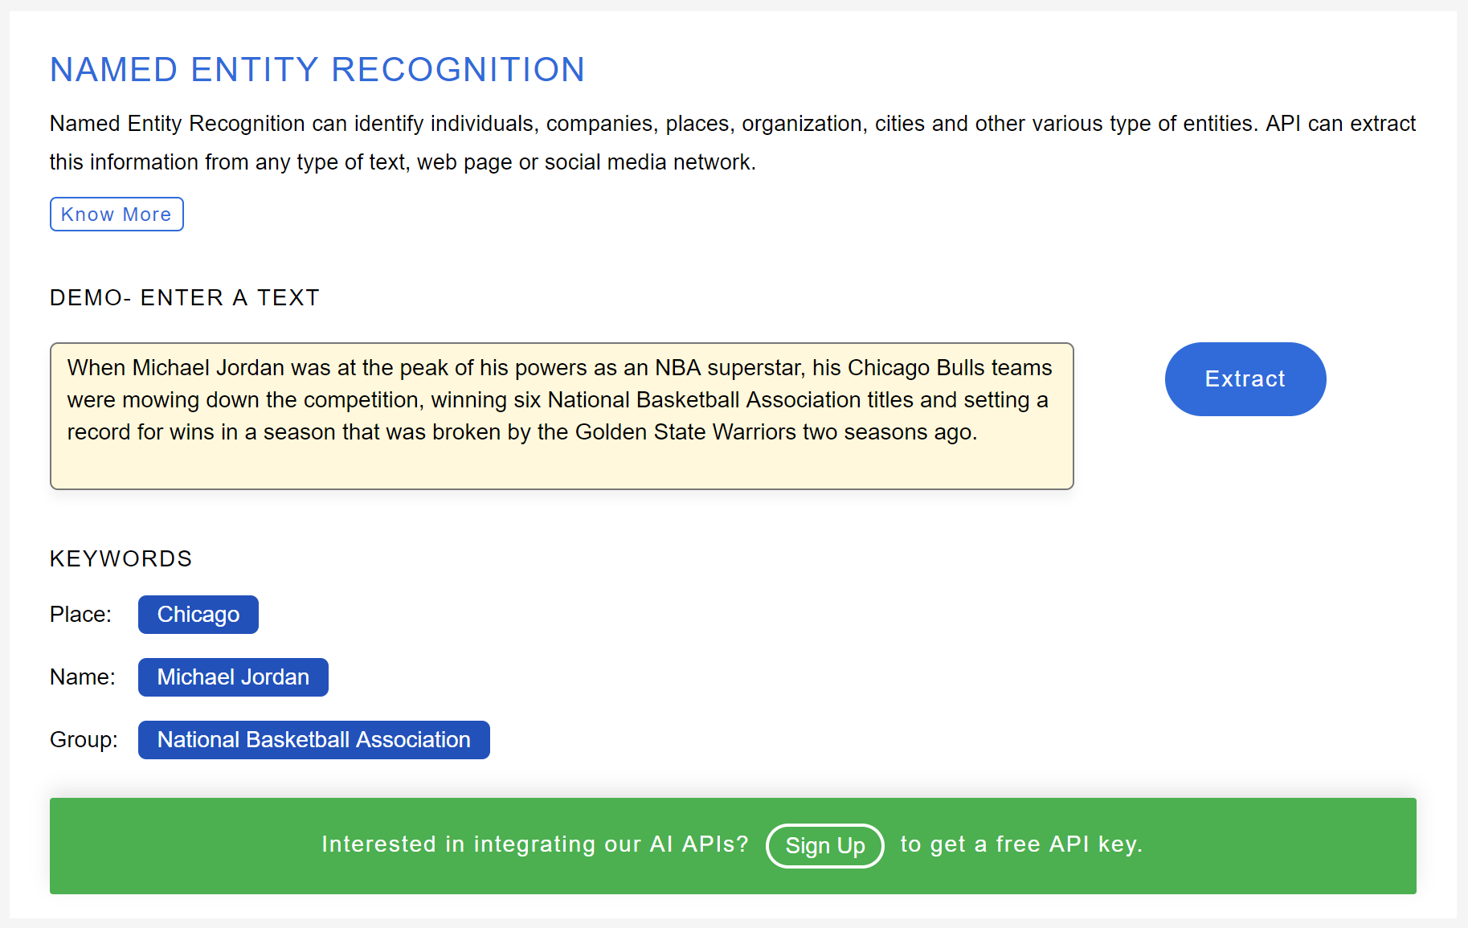
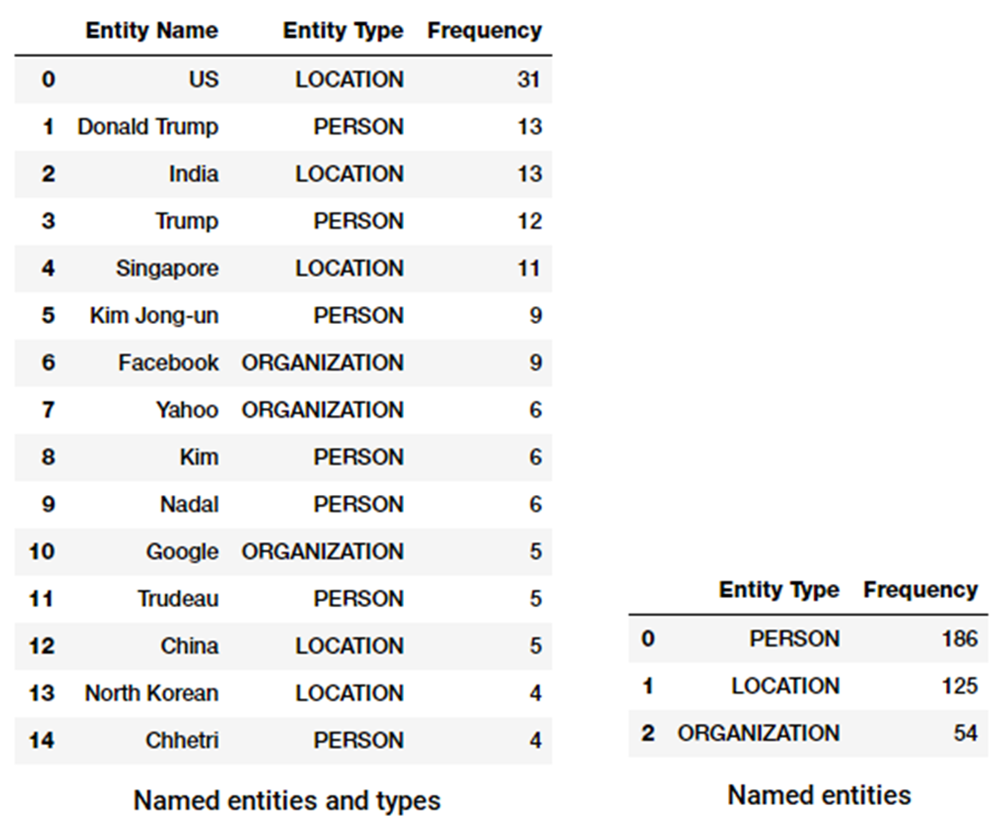

Slide 14
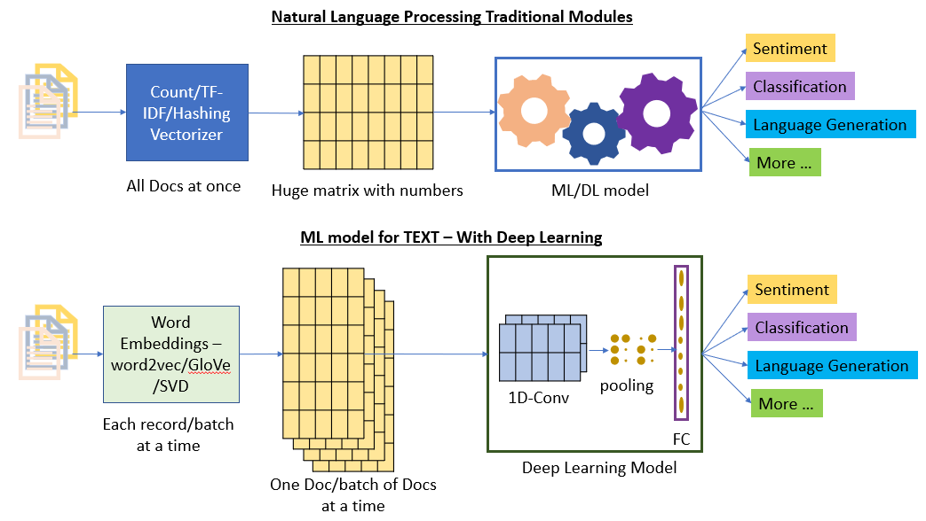

Slide 15
NLP Tools
NLTK, Scipy, Carrot2 – Libraries for Python Environment
Amazon Comprehend - Uses machine learning to find insights and relationships in text
Google Cloud NL API - AutoML NLP API’s
Apache OpenNLP, Tika (open source-JAVA Based)
CLARIN Infrastructure
Azure NLP

Slide 16
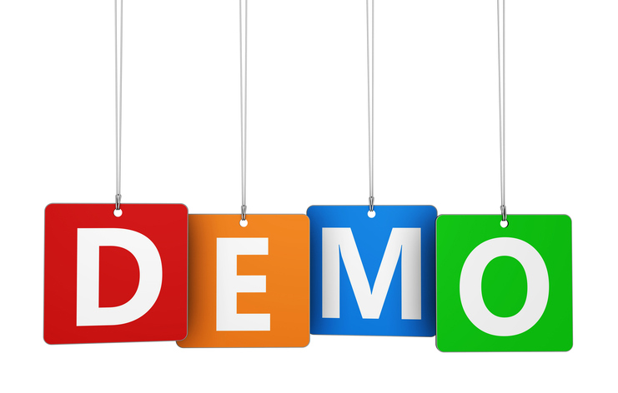
NLP Pre-Processing Using NLTK & Spacy

Slide 17


